Slide 1

ISO 19450 OPM –
Object-Process Methodology Update
Dov Dori
January 30, 2021
ISO, "ISO/PAS 19450 Automation systems and integration – Object-Process Methodology,"
15 Dec. 2015. Available: https://www.iso.org/obp/ui/#iso:std:iso:pas:19450:ed-1:v1:en.

Slide 2
ISO/PAS 19450:2015 – OPM
Object-Process Methodology Update
2009: Work started within ISO TC184/SC5
2015: Approved as a PAS (Publicly Available Specification)
2018: Approved for a second 3-year term as a PAS
2021: Planned to be approved as an IS (International Standard)
2021- 2022: Preparation of ISO 19450:2022 – OPM enhanced with new capabilities:
  Computational objects & processes
  Stereotypes, Templates…
  Simulation & Execution; Real-time IoT Operating System

Slide 3
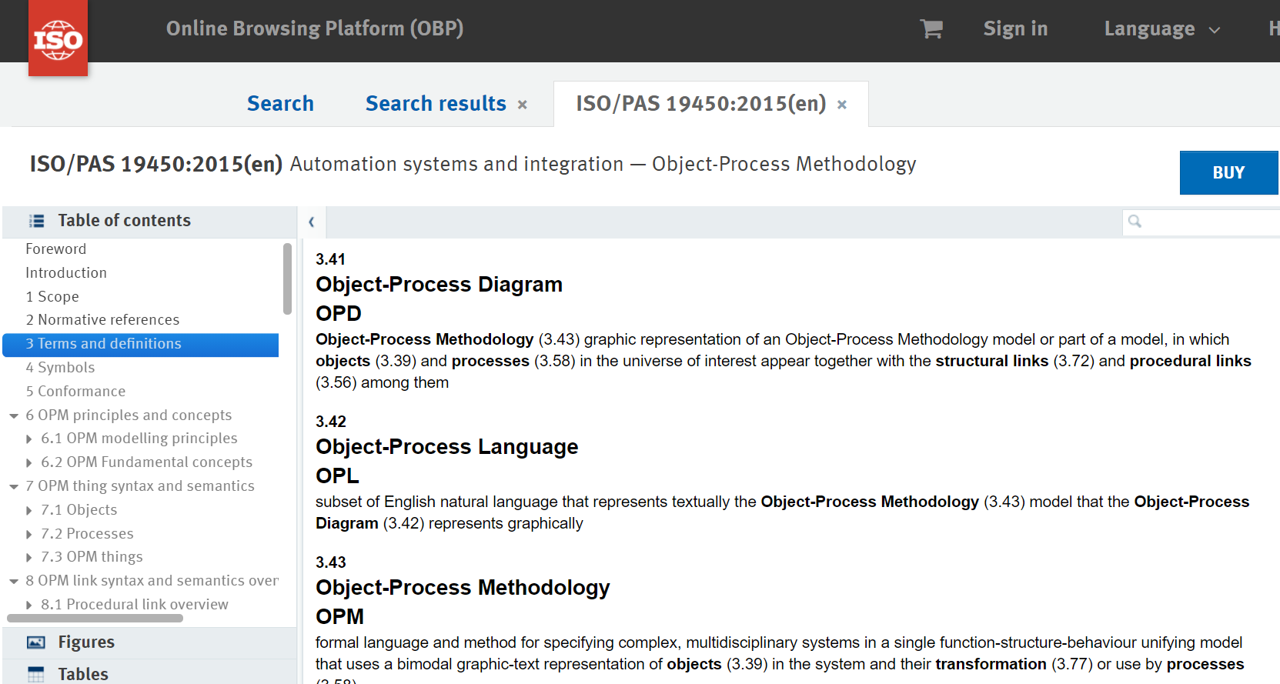
ISO/PAS 19450:2015 – OPM
Object-Process Methodology Update
2009: Work started within ISO TC184/SC5
2015: Approved as a PAS (Publicly Available Specification)
2018: Approved for a second 3-year term as a PAS
2021: Planned to be approved as an IS (International Standard)
2021- 2022: Preparation of ISO 19450:2022 – OPM enhanced with new capabilities:
  Computational objects & processes
  Stereotypes, Templates…
  Simulation & Execution; Real-time IoT Operating System
[1] D. Dori, Object-Process Methodology – A Holistic Systems Paradigm, Springer Verlag, Berlin, Heidelberg, New York, 2002.
[2] ISO, "ISO/PAS 19450 Automation systems and integration – Object-Process Methodology," 15 Dec. 2015. Available: https://www.iso.org/obp/ui/#iso:std:iso:pas:19450:ed- 1:v1:en.

Slide 4
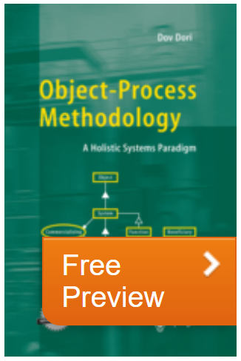
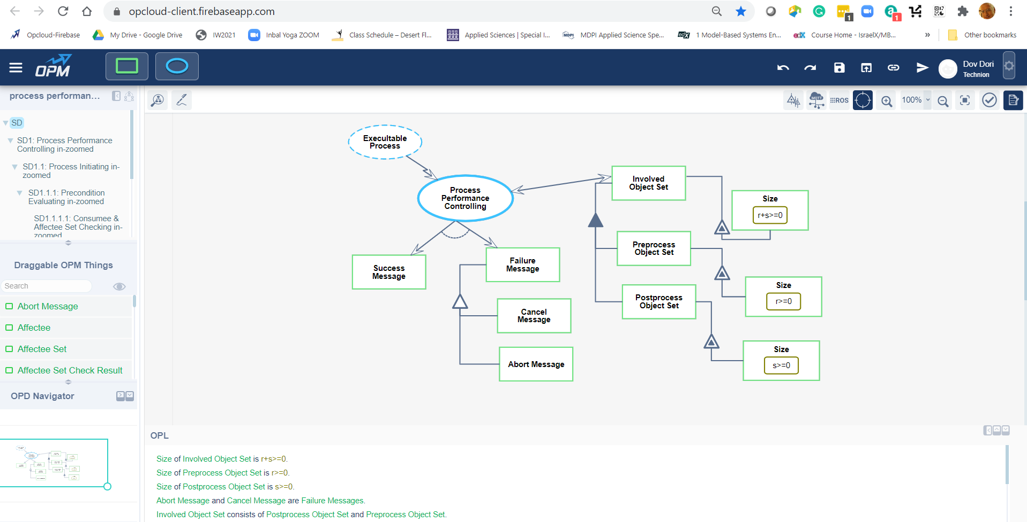
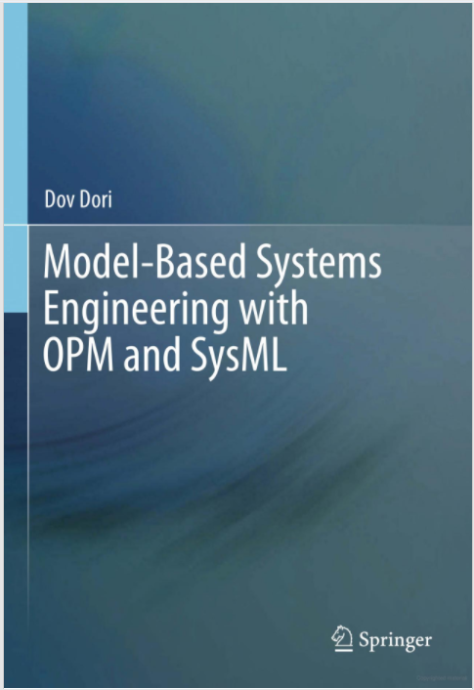
OPM: Resources
OPCloud
Details: https://www.opcloud.tech/
Try it out: https://sandbox.opm.technion.ac.il/
Enterprise Systems Modeling Laboratory: http://esml.iem.technion.ac.il/

Slide 5
ISO TC184/SC5/SG5:
Model-Based Standards Authoring
A model-based standard that specifies how to produce a model-based standard
Applicable to both existing and new standards
This standard is itself model-based, exemplifying how to do it
The model is expressed in the Object-Process Methodology (OPM) language ISO 19450

Slide 6
Rationale
Standards are based primarily on natural language, often accompanied by graphics.
Representation through the natural language leads to some challenges:
  it is a source of ambiguities, omissions, lack of consistency, and possible contradictions both within the text and between the text and the graphics.
These issues grow with the size of the document and are difficult to track due to the informal nature of natural languages, hindering automated verification and validation.

Slide 7
SG5 Objective
Develop a model-based standard for model-based standards authoring
  Specify how to create standards using an OPM model that is translated automatically to a subset of natural language text.
Streamline, formalize, and explicate the formation of new and existing standards
  Standards will be more comprehensive, accessible, usable, and consistent
  Internally, as well as within and across and across domains.

Slide 8
SG15 Committee Draft and Participants
We have prepared the Committee Draft “Meta-model for model-based standards authoring”.
ISO SG5 members:
  Dov Dori dori@technion.ac.il Co-convenor
  Richard Martin richardm@tinwisle.com Co-convenor
  Markus Stumptner mst@cs.unisa.edu.au Australia
  James Brucato jamesbrucato@gmail.com Italy
  Hongye Su hysu@iipc.zju.edu.cn China
  Hanshan Shao shaohanshan@zju.edu.cn China
  Xiaochen Li lixiaochen@zju.edu.cn China
  Gordon (Shao, Guodong) guodong.shao@nist.gov
  Hanan Kohen hanank@technion.ac.il
  Natali Levi soskin.natali@gmail.com
  Niva Wengrowicz nivawen@technion.ac.il
  Ahmad Jbara ahmadjbara@gmail.com
  Laurent Borne laurent_p_borne@whirlpool.com
  Yaroslav Menshenin y.menshenin@skoltech.ru

Slide 9
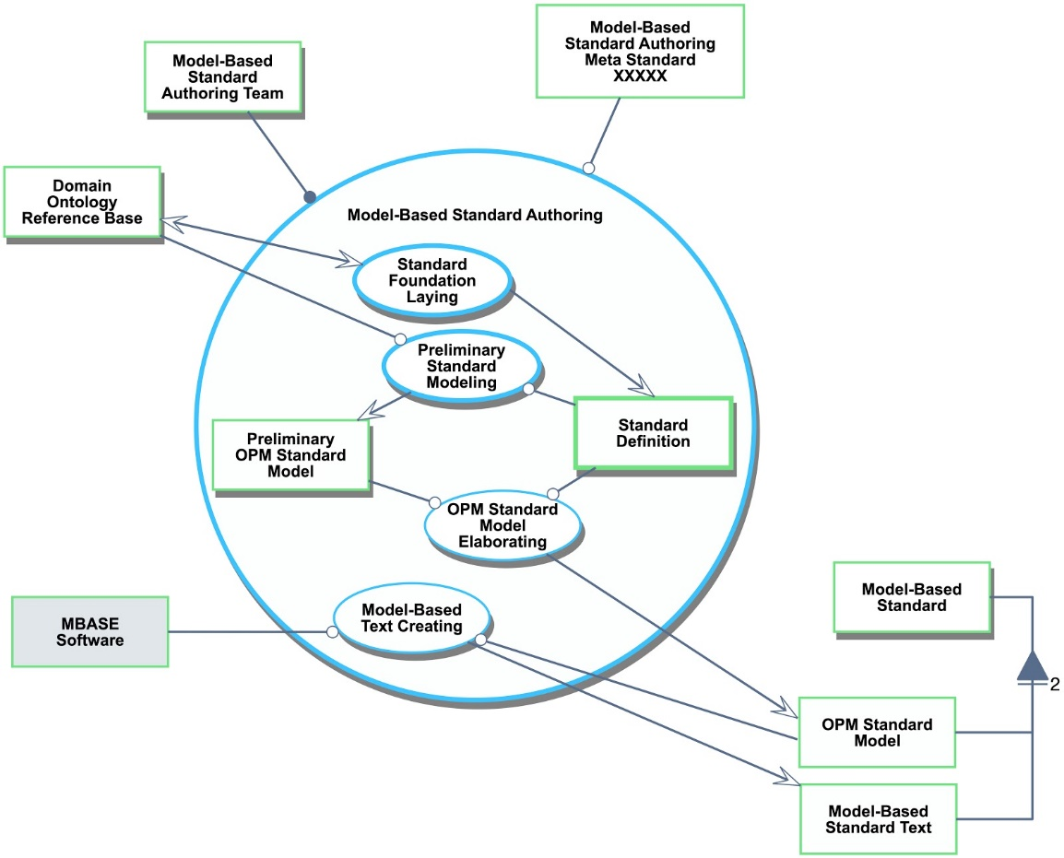
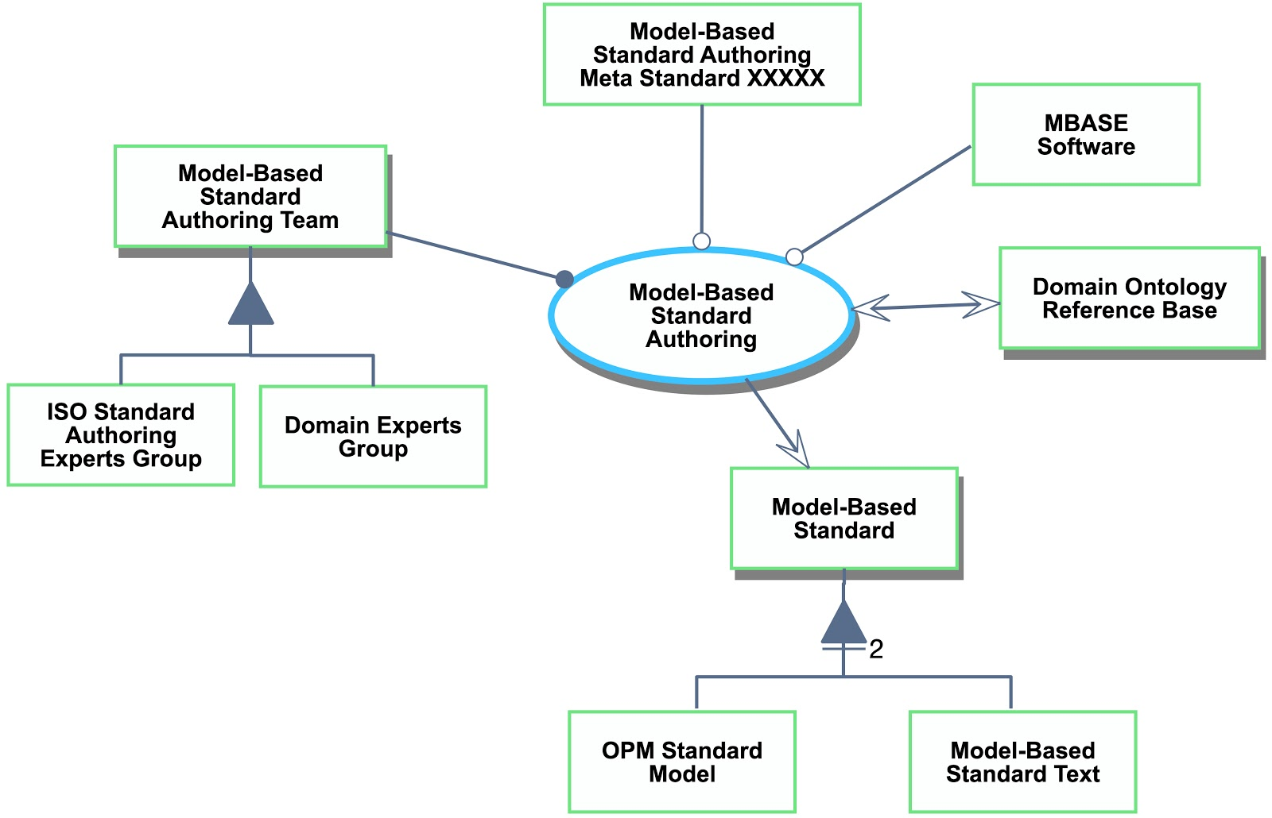
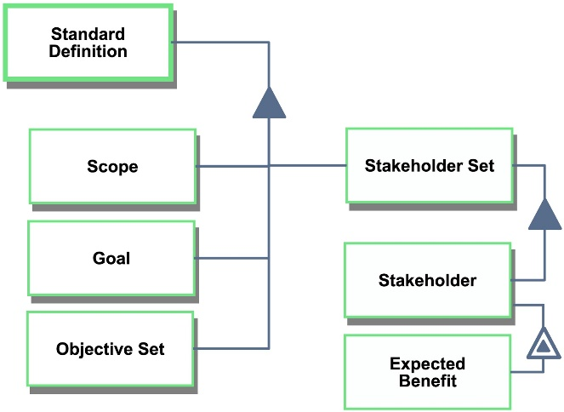
SG5 Model-Based Standards Authoring Diagrams
Model-Based Standards Authoring
process in-zoomed
Standard Definition
view
Model-Based Standards Authoring System Diagram (SD)

Slide 10
ISO TC184/SC5 Resolutions:
January 27, 2021 (Virtual Meeting)
SG5 is converted to WG15 and WG15 is established.
Working Draft SC5_N1112-v3 is adopted and moved to the next stage of IS development.

Slide 11
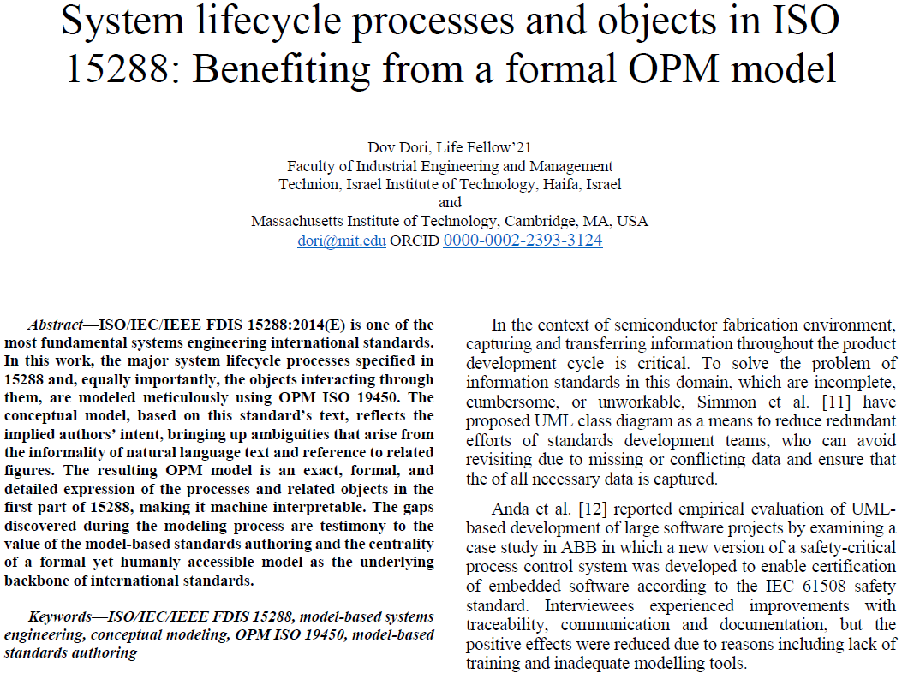
Proof of Concept

Slide 12
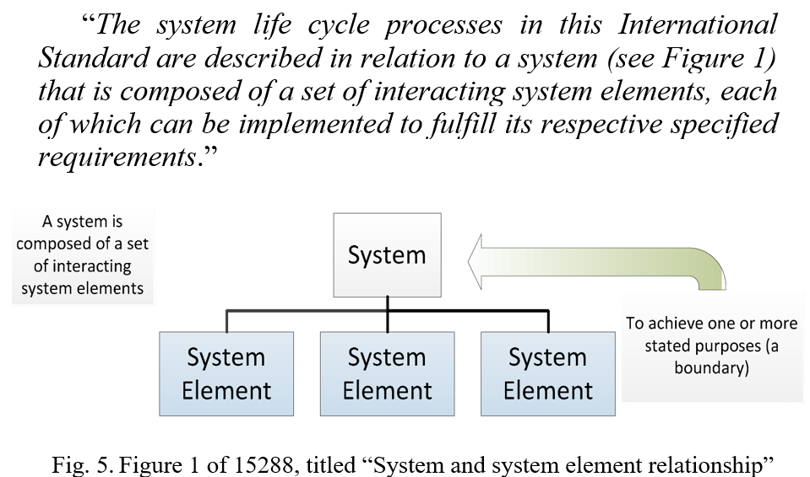
15288 Clause 5.2.2 contains Figure 1
and reference to it in the text, which reads:

Slide 13
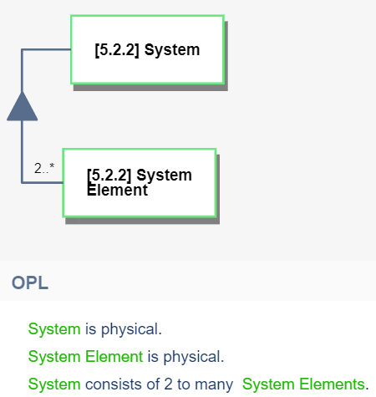
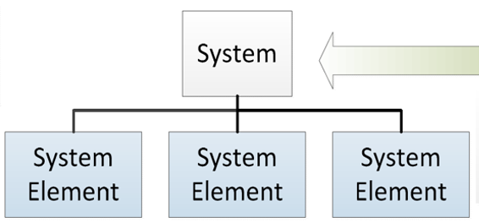

Translation of 15288 Figure 1 Into an OPM Model

Slide 14
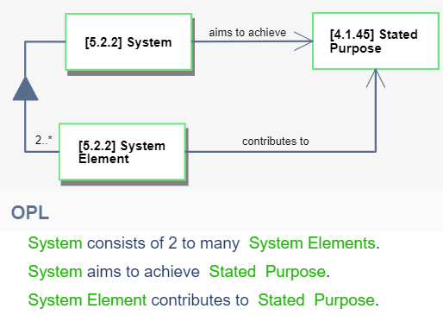
Adding the Text from 15288 Figure 1 into the OPM Model

Slide 15
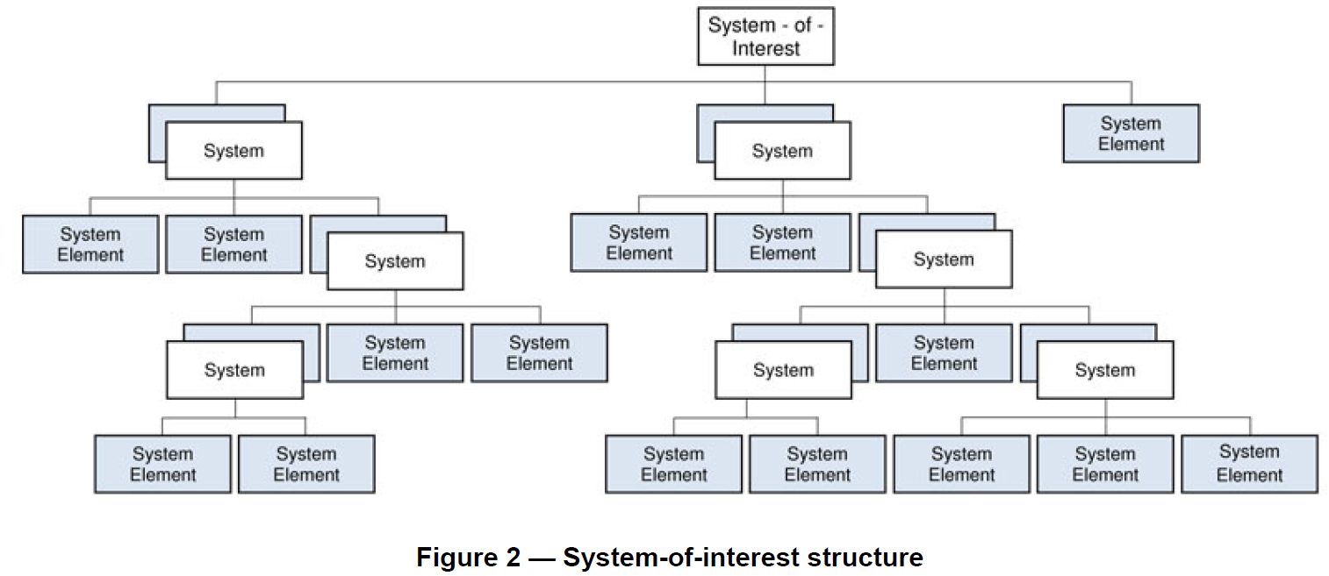
15288 Figure 1 vs. Figure 2: Why Different Symbols??

Slide 16
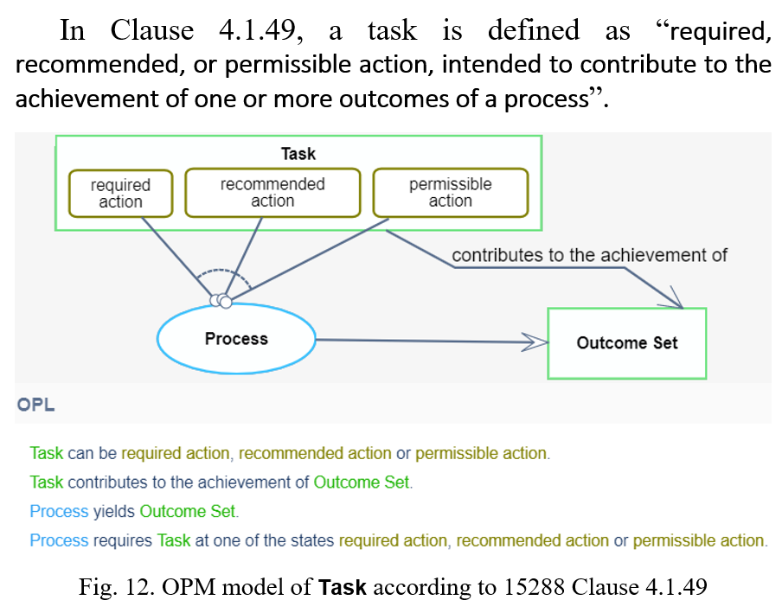
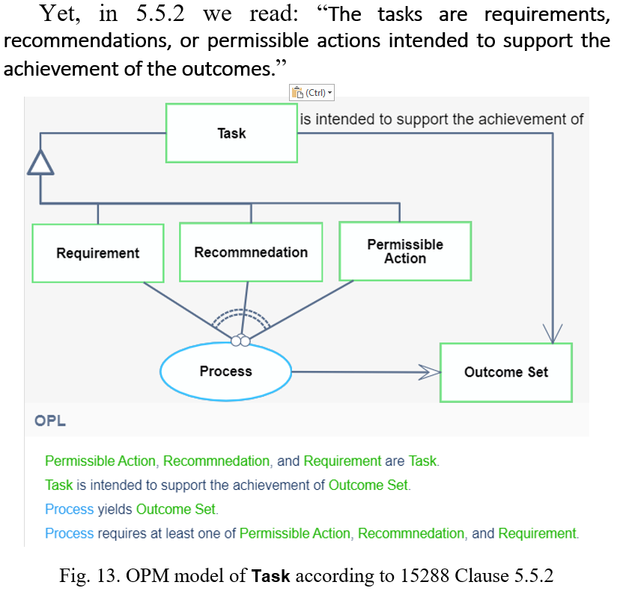
15288 – Two 15288 task definitions?

